Slide 1

Identifying Important sentences from Research Papers

Slide 2

Meet Team 4
19071A0504
Anusha Kadali
19071A0511
Harshita Chundru
19071A0536
Pranathi Munnangi
19071A0539
Neelima Kodedhala
19071A0557
Tanuja Maloth
Under the guidance of
Ch Rama Satya
Asst. prof

Slide 3
Introduction
System requirements
Modelling Diagrams
References
Abstract
Literature Review
System Architecture
Modules
Implementation
Test Cases
Limitations & Future scope
Conclusions
Agenda

Slide 4
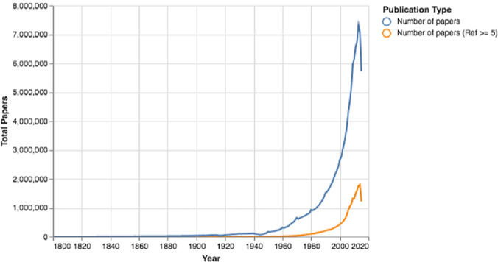
Introduction
The term research paper refer to a scholarly article that contains the results of original research or an evaluation of research conducted by others.
Scientific publications address a lot of research related questions about
target data set
state-of-art techniques
novel approaches
baseline systems and other information like pre/post processing pipelines and results.

Slide 5
Abstract
In the past century, the academic publishing world has changed drastically in volume and velocity. Researchers state their findings plainly and with corresponding evidence so that other researchers can consequently use the paper in their own research. Today’s researchers can publish not only in an ever-growing number of traditional venues, such as conferences and journals, but also in electronic preprint repositories and in mega-journals that provide rapid publication times. With abundantly growing size of publications every year, manually reading and analysing the documents is a hassle. We aim to develop a system that can automatically parse the target set of published articles to automatically identify important sentences. However, this is challenging because getting labelled data set per domains is expensive. So, we propose to build models that work with limited data sets per domain.

Slide 6
Literature Review
Paper No. | Title | Methodology | Pros/Cons | Year
1 | Contract Information Extraction Using Machine Learning | To extract this key information from the contracts,Named Entity Recognition(NER) along with other classifiers is used. A framework is created with a sample of contracts. Research was conducted to determine if using the Stanford NER algorithm was as effective as training a custom model for generic entity recognition. | Initially, the model is trained on a sample of contracts. Each contract is converted into SPACY object to perform NER on data. the overall execution time is long | 2021
2 | Key Information Extraction From Documents: Evaluation And Generator | a template based document generator is created to generate datasets of semi-structured documents, that can be used to compare models for information extraction from documents. | The results have shown that NLP based pre-processing is beneficial for model performance the use of a bounding box regression decoder increases the model performance only for fields that do not follow a rectangular shape. | 2021
3 | Information Extraction from Biomedical Text Using Machine Learning | First, an exploratory analysis of drug labels using a Natural Language Processing pipeline is performed. Second, Machine Learning algorithms have been employed to build baseline binary classification models to identify pediatric text in unstructured drug labels. Third, a series of experiments have been executed to evaluate the accuracy of the model. | Review of the results indicated that the prototype has a recall of 0.93 and precision of 0.86. The most daunting challenge in biomedical information extraction is the large number of data sources, for example, medical records, drug labels and gene interactions. | 2019

Slide 7
Literature Review
Paper No. | Title | Methodology | Pros/Cons | Year
4 | Text Classification Using Machine Learning Techniques | Read Document Tokenize Text Stemming Delete Stopwords Vector Representation of Text Feature Selection and/or Feature Transformation Learning algorithm | Distinguishing between different meanings of a word (called word sense disambiguation) is not easy, often requiring the context in which the word appears. | 2017
5 | Text Classification of Technical Papers Based on Text Segmentation | Several models with different feature sets from different segments are trained and combined. Furthermore, new features associated with the title of the paper are introduced. | Proposed a feature selection method based on the structure of the paper | 2019
6 | Text Summarization by Sentence Extraction Using Unsupervised Learning | Proposed a language- and domain-independent automatic text summarization approach by sentence extraction using an unsupervised learning algorithm. The hypothesis is that an unsupervised algorithm can help for clustering similar ideas (sentences). | The proposed approach is more independent from language and dominion. | 2016

Slide 8
Literature Review
S.NO | Title | Methodology | Pros/Cons | Year
7 | NLP CONTRIBUTION GRAPH - Structuring Scholarly NLP Contributions for a Research Knowledge Graph | Different teams used different classifiers to approach the problem. Few teams used BERT based binary classifiers and few used BERT based multi-class classifiers to identify contributing sentences. To identify predicates and scientific terms sequence labelling approaches are used by most of the teams. | The best system adopted a hybrid approach which seemed the most effective strategy for building the NCG end-to-end task performance was low showing the task considerably challenging, each individual subtask toward obtaining an NCG, i.e. contribution sentence classification, scientific terms and relations extraction, and triples formation | 2021
8 | Effective Information Extraction Framework for Heterogeneous Clinical Reports Using Online Machine Learning and Controlled Vocabularies | The main idea of this paper looks at data extraction from clinical reports using machine learning. Use of natural language processing also plays a key role in this problem statement. Here is used to support the parsing with its Sentence Detector, Tokenizer, and Part-of-Speech Tagger. A reverse index of tokens is created to support efficient keywords-based search. | IDEAL-X adopts a unique online machine learning–based approach combined with controlled vocabularies to support data extraction for clinical reports. The system can quickly learn and improve, thus it is highly adaptable. in cases where controlled vocabularies are unavailable—extracting generic named entities for example, maintaining high accuracy is a challenge | 2017
9 | Using Text Mining Techniques for Extracting Information from Research Articles | The primary goals of this research are (1) Using text mining techniques for identifying the topics of a scientiﬁc text related to ML research and developing a hierarchical and evolutionary connection among these topics. (2) Using visualiza- tion tools for presenting both the topics and the association among them as a convenient way to help users to determine relevant topics. | Results revealed that the similarity operator could not detect a clear similarity among some topics the reason is that these topics are interrelated and similar in meaning to each other | 2018

Slide 9
Literature Review
Paper No. | Title | Methodology | Pros/Cons | Year
10 | Single Document Automatic Text Summarization Using Term Frequency-inverse Document Frequency (Tf-idf) | 4 main steps - preprocessing of text, features extraction of both words and sentences, sentence selection and assembly, and summary generation. The F-Measure as the standard comparison value had been used. | An accuracy of 67%, which is higher compared to the other online summarizers. While accuracy is higher compared to others, it is still low | 2016
11 | Improving Performance of Text Summarization | Each sentence is associated with 8 feature vector. the score for each sentence are derived using fuzzy logic method. The fuzzy rules are in the form of IF-THEN .The triangular membership function fuzzifies each score into one of 3 values that is LOW, MEDIUM & HIGH. Then we apply fuzzy rules to determine whether sentence is unimportant, average or important. | Latent Semantic Analysis (LSA) is designed to improve the effectiveness of information retrieval methods by using "semantic" content of words in a query as opposed to performing direct word matching. Precision-90%. We need to extend the proposed method for multi document summarization with a large data sets and domain specific data. | 2014

Slide 10
Literature Review
Paper No. | Title | Methodology | Pros/Cons | Year
12 | Knowledge Discovery using Text Mining: A Programmable Implementation on Information Extraction and Categorization | Implementation of Information Extraction and Categorization in the text mining. To extract terms from the document they used modified version of Porter’s Algorithm for inflectional stemming. For calculating term frequencies for categorization, they used a domain dictionary for ‘Computer Science’ domain. | With categorization techniques, systems can assign previously unseen documents to the most suitable category available, based on a particular taxonomy or topic. The application currently provides accurate results only documents which are related to the Computer Science field. The domain dictionary is populated with very little words as compared to the amount words it should actually have. | 2009
13. | Comparing information extraction techniques for low-prevalence concepts: The case of insulin rejection by patients | Conceptually it is a binary classification: each sentence is examined to determine the presence/absence of a patient refusing insulin. They performed sentence-level classification applying three models: Naïve Bayes, Logistic Regression , and a linear Support Vector Machine. | Rule-based systems that include the designer’s background knowledge of language may be able to achieve higher accuracy under these circumstances. challenges are more pronounced for identifying low-prevalence information: hundreds of documents might have to be analyzed to locate a single instance of the target information. | 2019

Slide 11
Literature Review
Paper No. | Title | Methodology | Pros/Cons | Year
14. | Machine Learning and Deep Learning based Information Extraction from Bangla Names | To classify the demographic information from names utilizing machine learning, we adopted five significant phases such as data collection, data prepossessing, training data, integrating ML and Deep Learning algorithms, predictions and evaluation. | The goal in our effort was to come up with a model that has a simple architecture and uses less time and memory resources. This way, we end up with models that are more efficient and more scalable. It is a critical issue to extract information from the Bangla names. | 2020
15. | Extracting Sentence Segments for Text Summarization: A Machine Learning Approach | Sentences are broken into segments by special cue markers. Each segment is represented by a set Of predefined features. Then a supervised learning algorithm is used to train the summarizer to extract important sentence segments, based on the feature vector. | The design of an automatic text summarizer is of great importance in the current world which is so filled with data. It would reduce the pain people suffer reading huge amounts of data by offering them a concise summary for each document. | 2018

Slide 12
System Architecture
Dataset
Machine translation
Folder 1
Paper.pdf
Gorbid-out.txt
Stanza-out.txt
Sentencex.txt
Cleaning and pre-processing
Apply tf-idf and get high rank sentences
Evaulate

Slide 13
System Requirements
Hardware Requirements:
Laptop or desktop
Processor: i3 and above
Ram: 4GB(minimum)
Software Requirements:
Ananconda 2021.11
Google Colab
Python 3.6

Slide 14
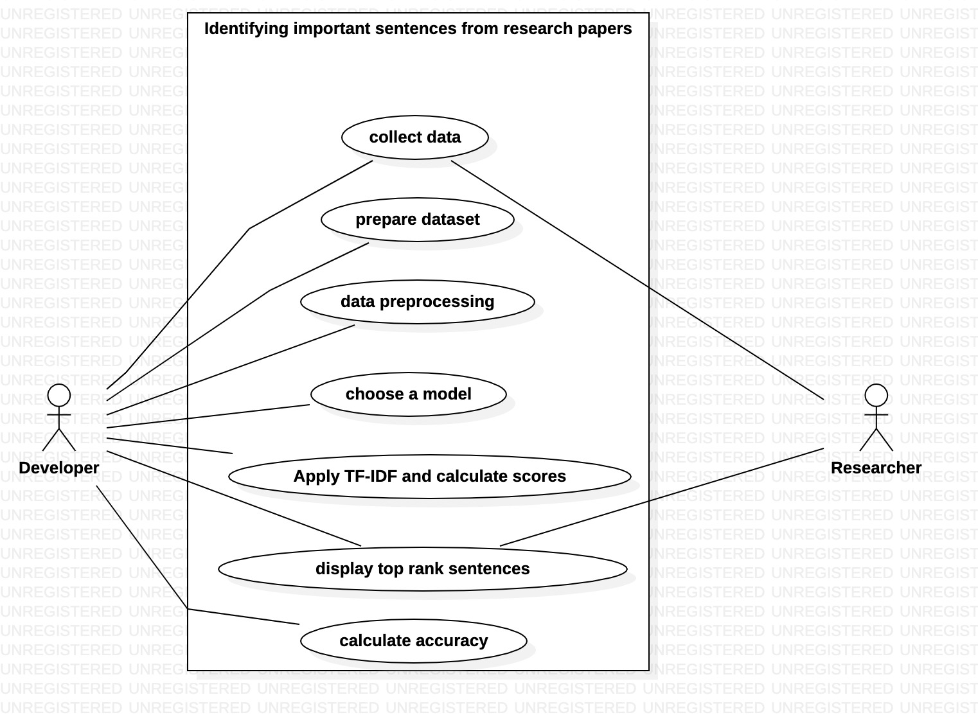
Use Case Diagram

Slide 15
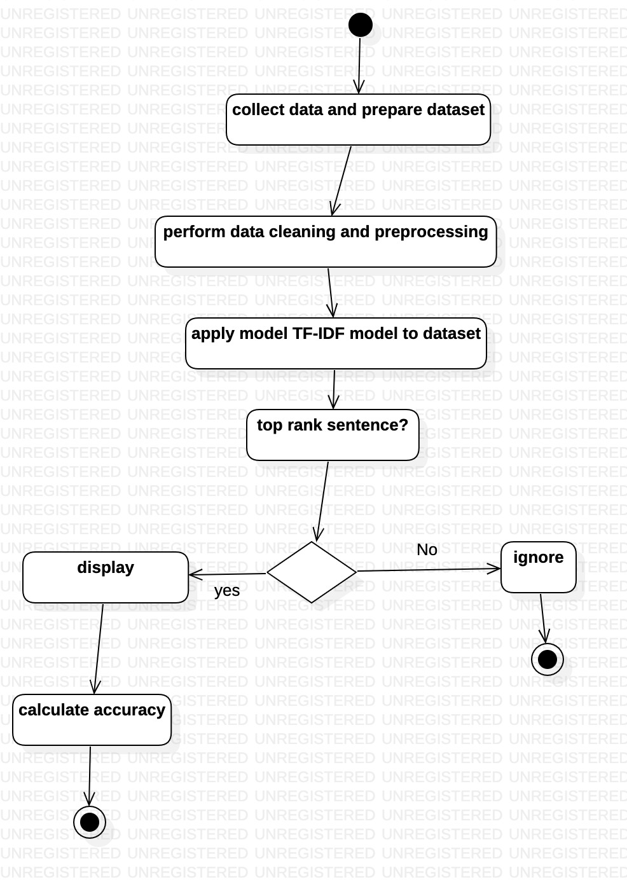
Activity Diagram

Slide 16
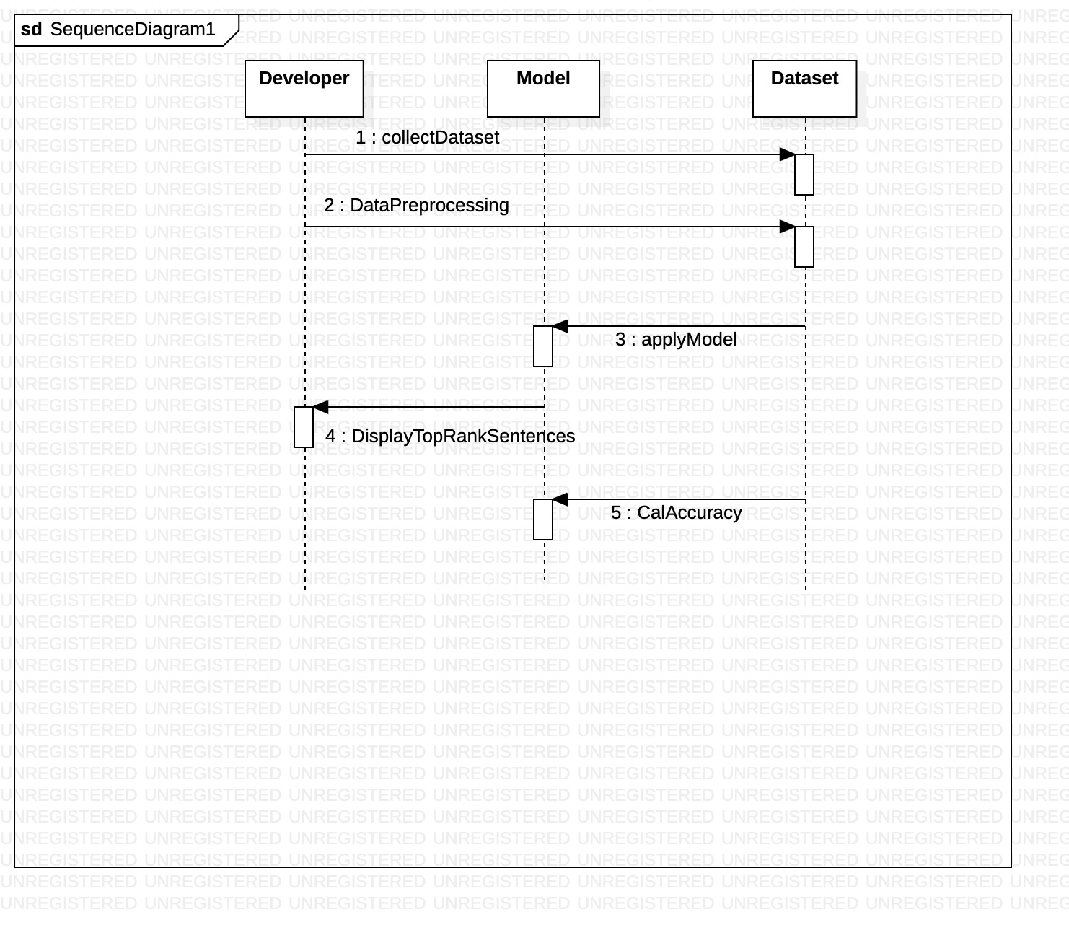
Sequence Diagram

Slide 17
Modules
Data Cleaning : Data cleaning is a process by which inaccurate, poorly formatted, or otherwise messy data is organized and corrected.
The two Data Cleaning techniques that we used in our project are:
Stemming
✤ Stemming is a technique used to extract the base form of the words by removing affixes from them.
✤ Stemming reduces the size of the index and increases retrieval accuracy.
Stopword removal
✤ These are actually the most common words in any language (like articles, prepositions,
pronouns, conjunctions, etc) and does not add much information to the text.
✤ By removing these words, we remove the low-level information from our text in order to give
more focus to the important information.

Slide 18
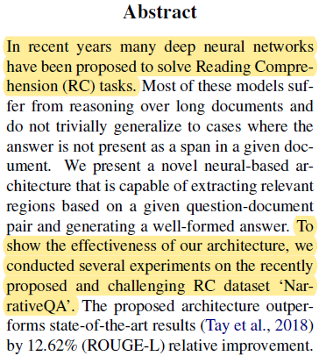
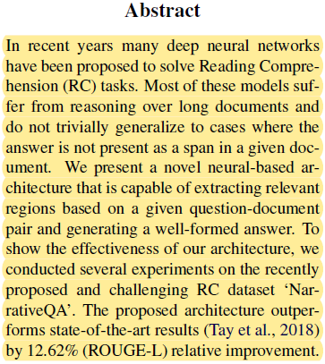
Modules
Baseline
'1’ Baseline Model
Assign all sentences as important in the model.
i.e., all sentences are assigned as '1'.
Lines | Imp or not | Model
In recent years many deep neural networks.... | 1 | 1
Most of these models suffer from.... | 0 | 1
We present a novel neural-based.... | 0 | 1
To show the effectiveness of our.... | 1 | 1
The proposed architecture outperforms.... | 0 | 1

Slide 19
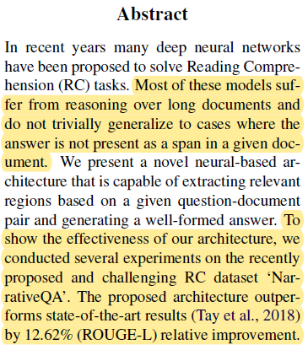
Modules
Baseline
Random Baseline Model
The important and unimportant lines are
picked at random.
So, it assigns 0 and 1 randomly to the sentences.
Lines | Imp or not | Model
In recent years many deep neural networks.... | 1 | 0
Most of these models suffer from.... | 0 | 0
We present a novel neural-based.... | 0 | 1
To show the effectiveness of our.... | 1 | 1
The proposed architecture outperforms.... | 0 | 0

Slide 20
Modules
TF-IDF : TF-IDF stands for “Term Frequency — Inverse Document Frequency”. This is a technique to quantify words in a set of documents.
By vectorizing the documents we can further perform multiple tasks such as finding the relevant
documents, ranking, clustering, etc. This exact technique is used when you perform a google search
(now they are updated to newer transformer techniques).
✤ Term Frequency
This measures the frequency of a word in a document.
tf(t,d) = count of t in d / number of words in d
✤ Inverse Document Frequency
IDF is the inverse of the document frequency which measures the informativeness of term t.
idf(t) = N/df

Slide 21
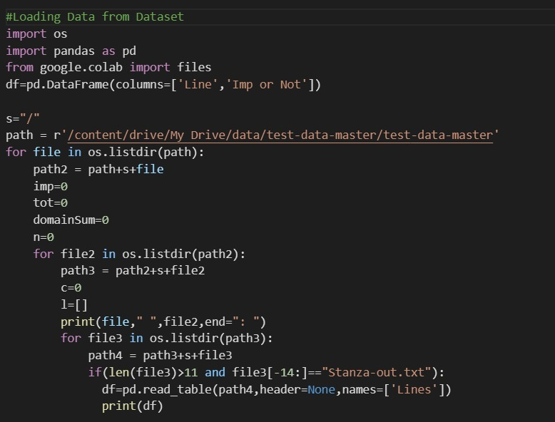
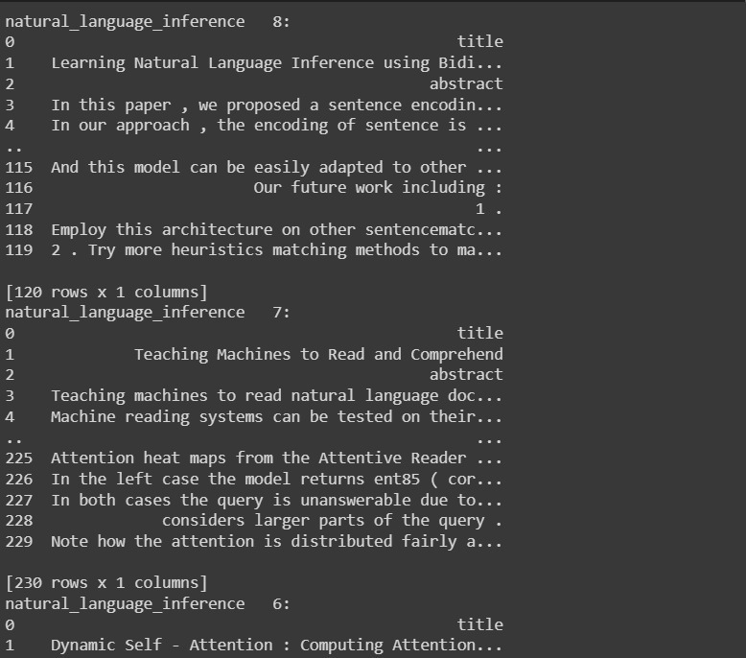
Implementation
Loading Data into Data Frames:

Slide 22
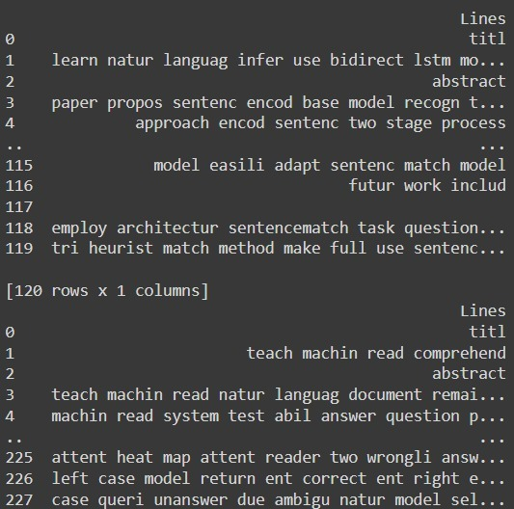
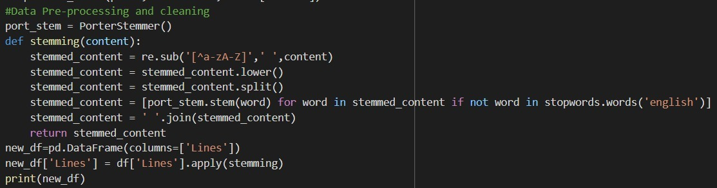
Implementation
Data Cleaning:

Slide 23
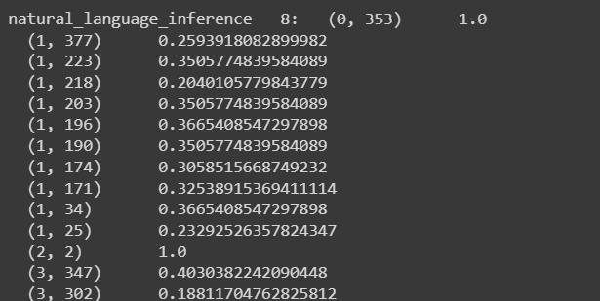
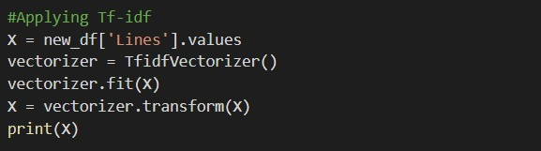
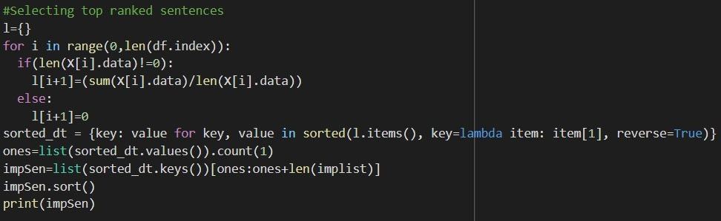
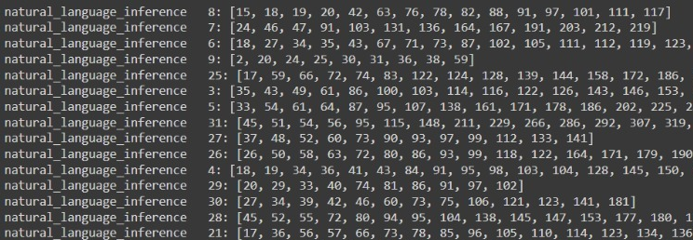
Implementation
Applying TF-IDF
Getting Top Ranked Sentences

Slide 24
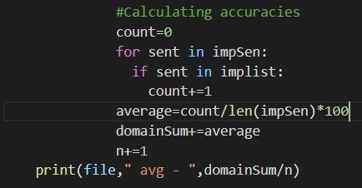
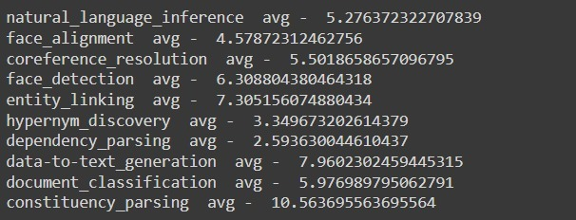
Implementation
Calculating Accuracies

Slide 25
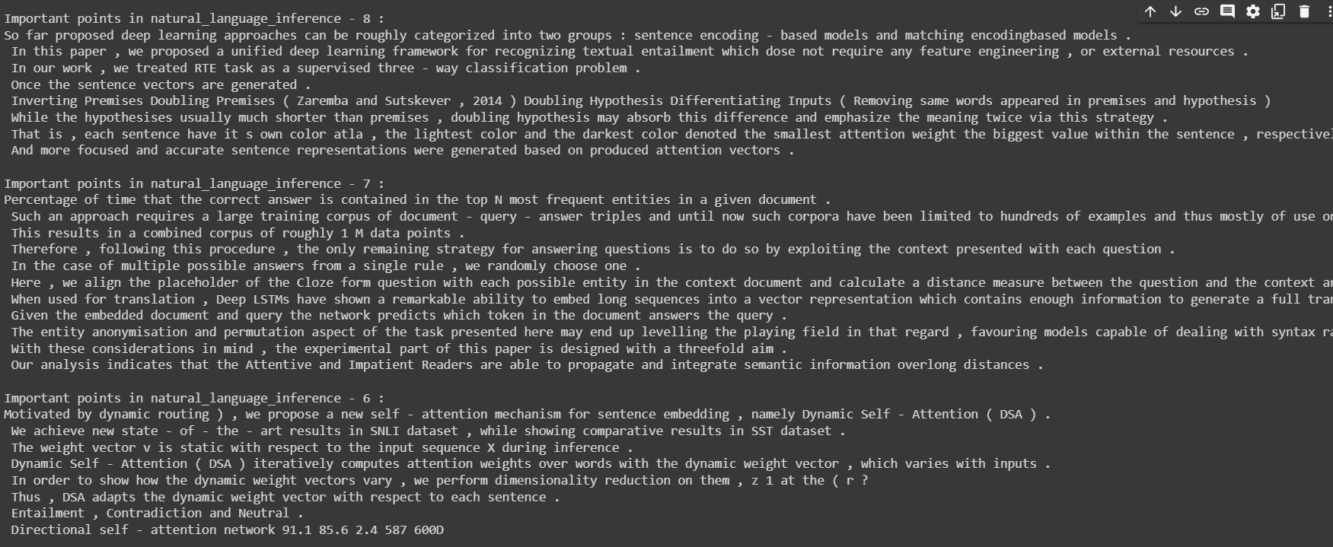
TESTCASES

Slide 26
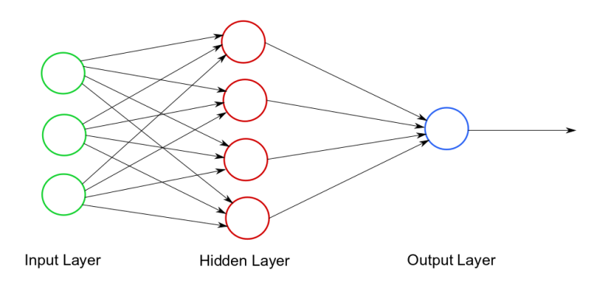
Limitations & Future Scope
Limitations
Less Accuracy
High training time
Biased dataset
Future Scope
Further, neural networks like LSTM,CNN can also be used to implement.

Slide 27
Conclusion
Implemented the project on TF-IDF MODEL
Different domains have highly varied accuracies
Due to high bias nature of dataset it difficult to improve accuracy

Slide 28
References
https://aclanthology.org/2021.semeval-1.44.pdf
https://www.researchgate.net/figure/The-number-of-papers-over-time-The-total-number-of-papers-has-surged-exponentially-over_fig1_333487946
https://www.nature.com/articles/d41586-021-01167-9

Slide 29
THANK YOU

